Slide 1
AI Material Generator Examples
EC530: Software Engineering Principals
Sohib Shafqat
4/27/2025

Slide 2
Initial Setup

Slide 3
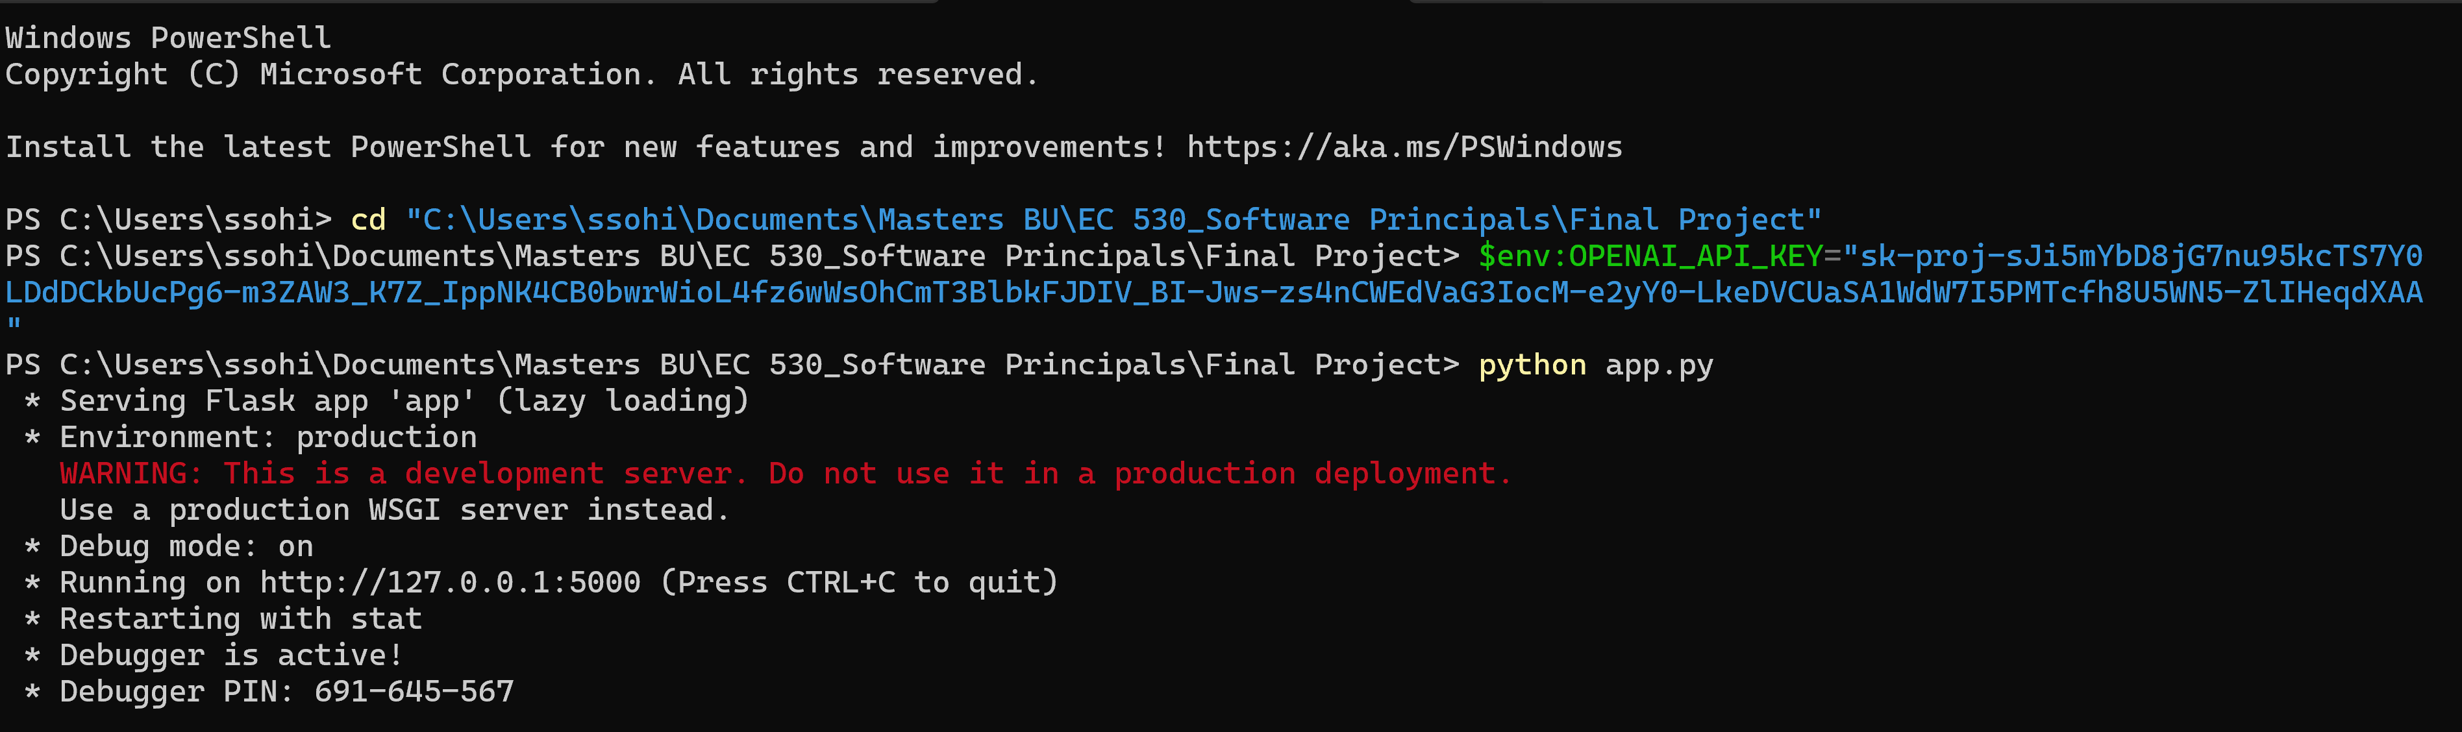
Initial Setup Run for Flask

Slide 4
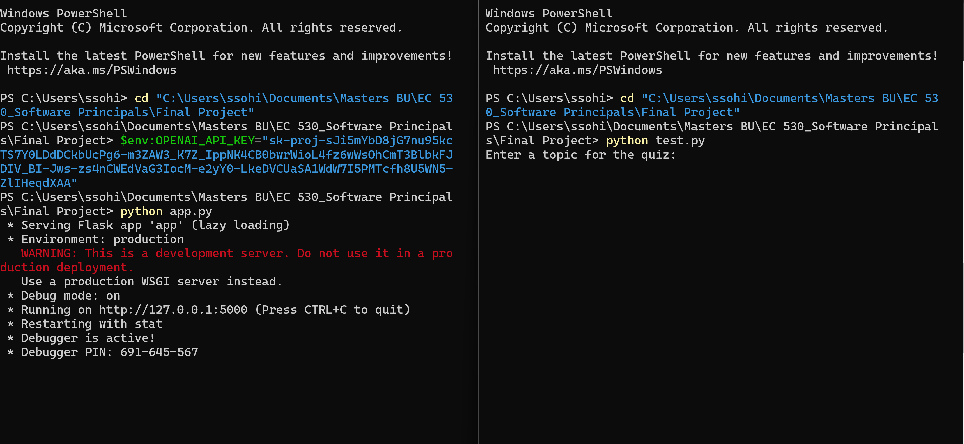
Two Terminals Side by Side
Open two terminals. Run app.py in one and test.py in the other.

Slide 5
Testing AI System

Slide 6
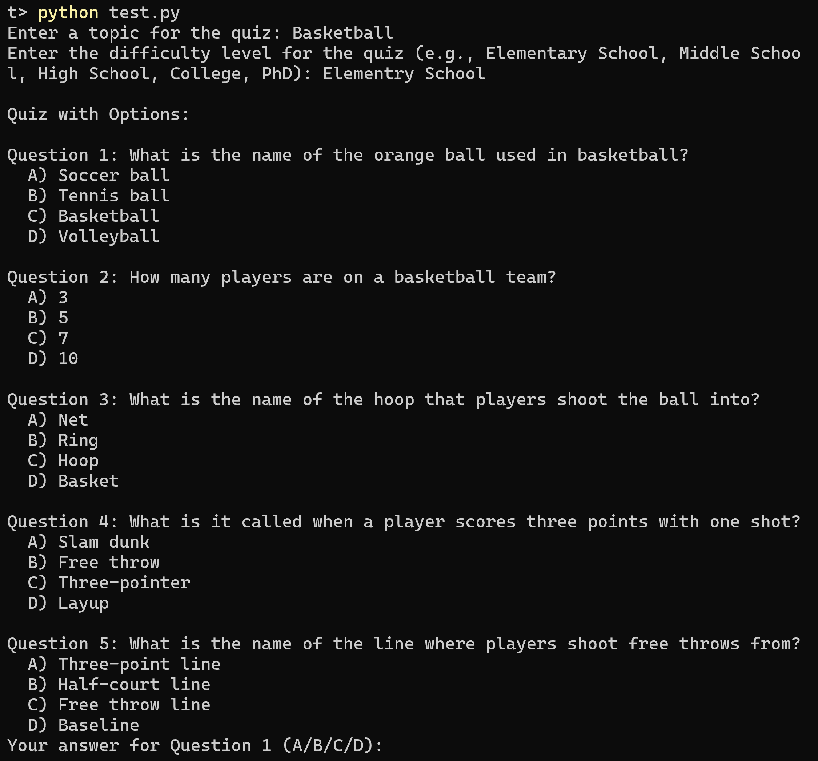
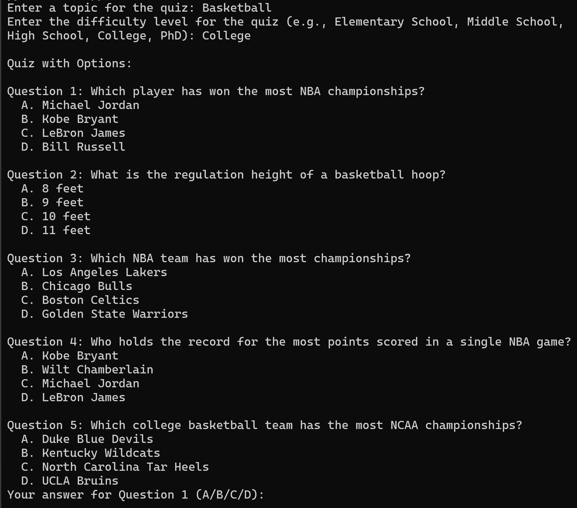
Testing Difficulty Level
This example is to test if the AI can detect the difficulty input by the user and change the question to represent that difficulty.
Test Passed: When the difficulty is set to ‘College’, AI is creating questions that are more complex and harder.

Slide 7
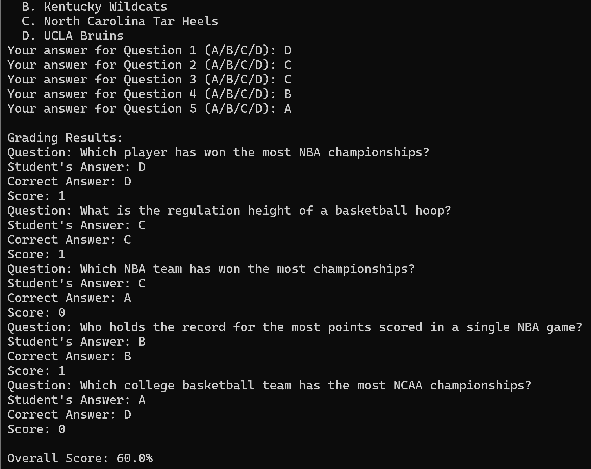
Testing Results Generator and Grading Algorithm
This example to test if the AI accurately generates the answers and grades the student's selection.
Test Passed: AI provided the correct answers and graded each question and provided the overall score.
I double checked each answer on google and got the same as the AI provided answer.
Questions
Answers

Slide 8
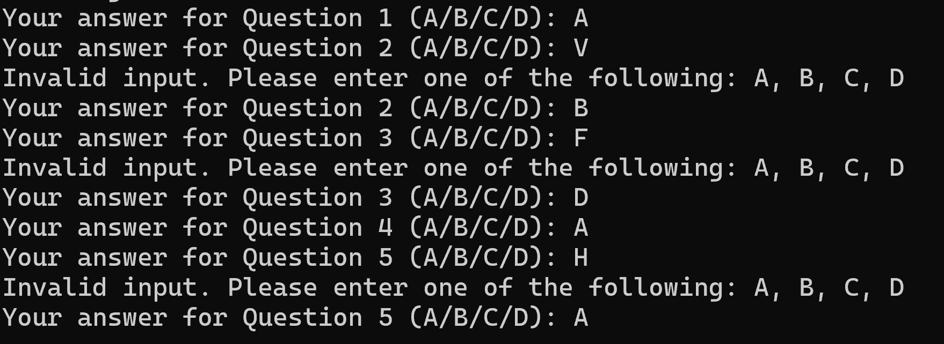
Testing for Errors
This example to test if the user incorrectly enters a letter other than the multiple choice letters, AI should output an error so that the user can try again.
Test Passed Successfully: When the letters V, F, H were input, an error message was given prompting the user to only select the available choices.

